Slide 1
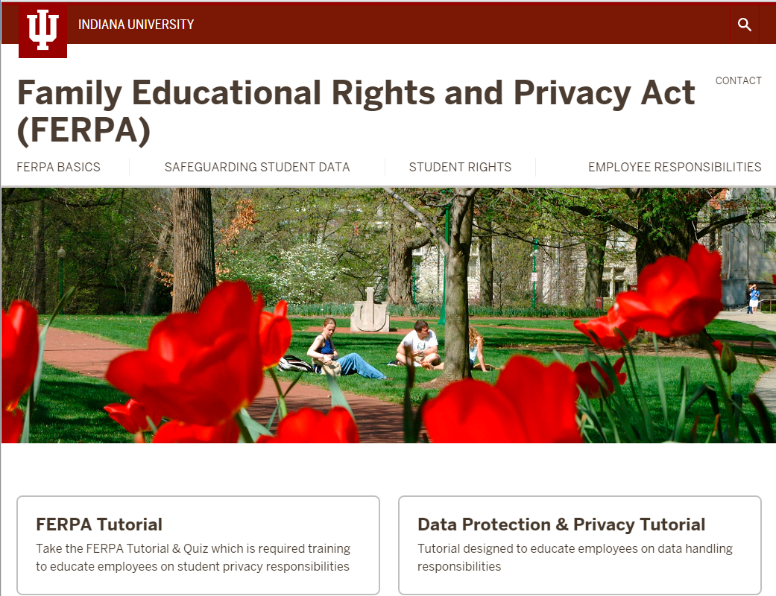
FERPA Tutorial Refresher
Requirement
All employees who have access to enterprise systems are required to complete the new FERPA tutorial!
Must pass the quiz with an 80% or better
We’ll work with you to get your departments in compliance
FERPA tutorial will be required every 2 years.

Slide 2
Student Privacy Changes
Policy Change
As of June 1, 2016, student address and phone numbers are no longer considered public.
Departments can still provide directories to school officials if needed as the information is university internal classification
Departments can provide directories to other students in the department only if they obtain written consent from the student.
What is public or FERPA directory information at IU*?
Name, Hometown (City, State, 5 digit zip only), major, etc… see https://ferpa.iu.edu/rights/public-info.html

Slide 3
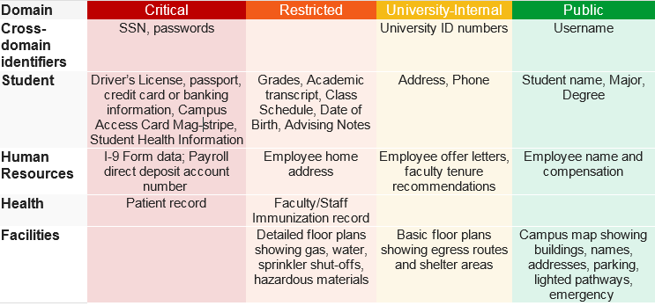
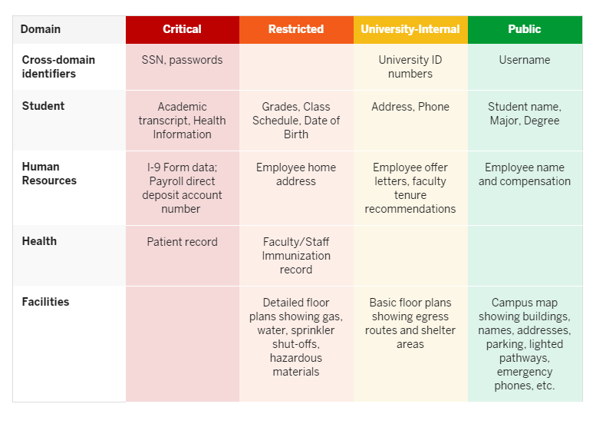
DM-01 Data Classification
Student Data Examples
Most student data falls under restricted!
Critical student data: SSN, Visa, Driver’s license, financial account information, and student health information
*NEW* Restricted: Transcript is now in this category if any critical data is redacted.
Public/Directory Information: Info released for things like open records requests, degree and enrollment verifications.
For more complete information on data classification by subject domain visit:
https://datamgmt.iu.edu/types-of-data/index.php

Slide 4
DM-01 Storage
Critical and restricted data must never be stored on mobile devices or local hard drives, without formal approval from the senior executive officer and appropriate technical safeguards (IT-12.1)

Slide 5
Storage & Collaboration Options
Ask questions if you are unsure of where to store or how to share sensitive data!
Platform/Service | Storage | Sharing | Data Classification | Comments
Intelligent Infrastructure | Yes | Yes | Critical*
IU Box Entrusted Data Account | Yes | Yes | Restricted | At IU, how do I request a Box account for use with sensitive data? https://kb.iu.edu/d/bfrt
IU Box Health Data Account | Yes | Yes | Critical (PHI) | No SSNs or credit card data
Onbase | Yes | Yes | Critical*
Office 365 |  | Yes | Restricted | No research or large datasets; Risks are administrative and must still comply with regulations (HIPAA, FERPA, etc.)
GAFE (Google) |  | Yes | Restricted | No research or large datasets; Risks are administrative and must still comply with regulations (HIPAA, FERPA, etc.)
IU Email (Exchange) |  | Yes | Restricted | Limit the volume. If sending PII of more than 100 use Secure Share for critical or another sharing option.
Secure IU File Server | Yes | Yes-internal | Assessed by department

Slide 6
Student Privacy Changes
PII-Personally Identifiable Information
SSN
University ID
Driver’s License Number
Financial Account information including Campus Access Card barcode
Health information
Address
Phone
Biometric Identifiers
Digital Signature
Email
License plate
Photo

Slide 7
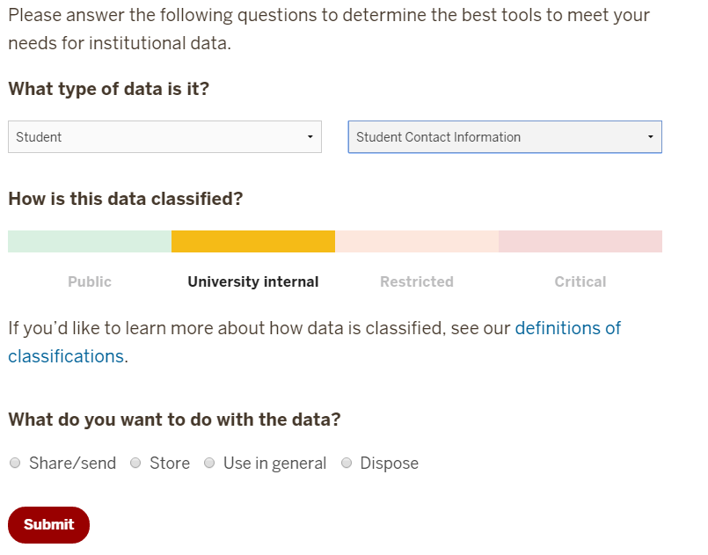
Storage & Collaboration Options
Ask questions if you are unsure of where to store or how to share sensitive data!
New Data Storage & Handling Tool
1. Select Student
2. Select Subdomain (Admissions, Bursar, FAFSA, Student Contact etc.)
3. Select if you want to Share, Store, Use, Dispose
4. Services and Tips will display

Slide 8
Laptop and Mobile Requirements
Don’t store or access critical and restricted data on personal laptops/devices without formal approval from the senior executive officer and appropriate technical safeguards.

Slide 9
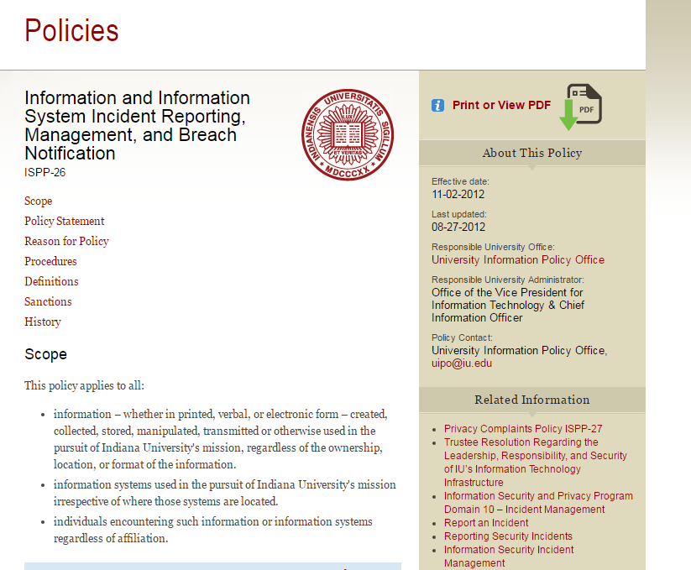
Student Privacy Changes
Incident Reporting & Breach Notification ISPP-26
The unit(s) experiencing the incident is/are responsible for all monetary, staff, and other costs related to investigations, cleanup, and recovery activities resulting from the compromise, response, and recovery. The unit(s) may consult with the Office of Insurance, Loss Control, and Claims as to methods for funding the incident.
Important to notify it-incident@iu.edu immediately!
For more information:
https://protect.iu.edu/online-safety/report-incident/index.html

Slide 10
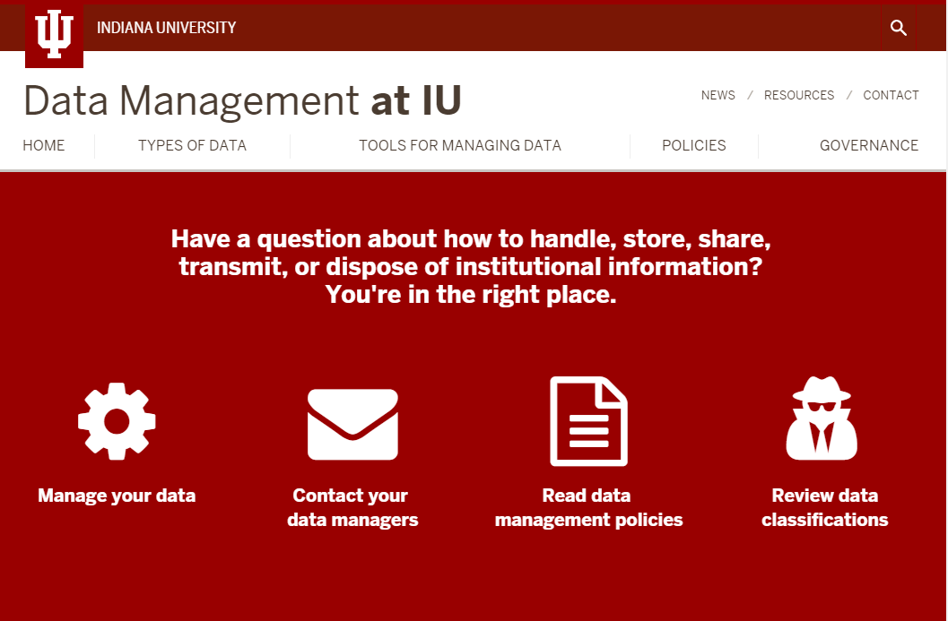
DATAMGMT.IU.EDU
CDS Website
News section- services approved for student data
Data Classification Matrix
Critical Data Guide (recommended for any new employee)
Tools (safeguard checklists for your internal developers, data protection tutorial)
DM policies including procedure for getting approval to share data with 3rd party cloud services
Tools available here:
https://datamgmt.iu.edu/tools/index.php

Slide 11
Data Steward Approval
When do you need approval?
Third party applications that will store or collect institutional data
Storing a new classification of data
Anything that might require an exception to policy related to DM-01 and DM-02
Seeking developer access to systems (including SUDS, SIS, HRMS, etc.).
Development of new systems or platforms (even internal) that will store critical data
Institutional Data Standards Checklist should be submitted to the appropriate Data steward
Self assessment available through: Safeguard Checklists for System Providers
Notes:
Don’t have before and after data on realignment so pulling the industrial best practice on Agile

Slide 12
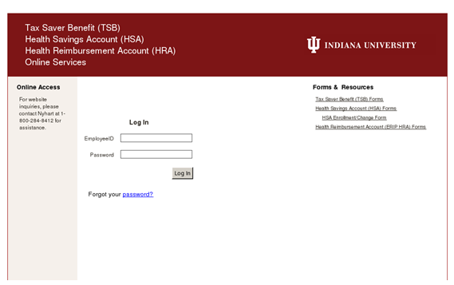
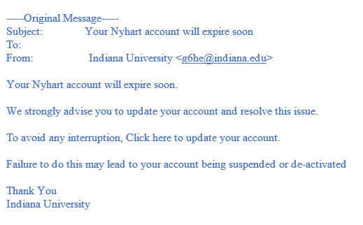
IT Incidents
Types of incidents…
Emailing an attachment that includes student information to the wrong recipient (i.e. a student or someone outside of IU)
Falling for a phishing attempt that compromises your passphrase.
Lost or Stolen Device
For more information on phishing scams: https://protect.iu.edu/online-safety/personal-preparedness/email-phishing.html

Slide 13
Email Guidelines
Preventative Tips to Limit Risk
Don’t send large datasets (>100) through email.
Do use Secure Share for critical data https://secureshare.iu.edu or CSEES https://kb.iu.edu/d/bbtq when sharing information about several students. You can invoke CSEES for your email by including [Secure Message] (case insensitive, with square brackets) in the subject.
Stay alert for phishing scams. If you suspect you have been compromised, change your passphrase immediately. Send phishing scams to phishing@iu.edu
Make sure mobile devices and laptops are encrypted
Notes:
Don’t have before and after data on realignment so pulling the industrial best practice on Agile

